Slide 1


U20CSPR02- MAJOR PROJECT : REVIEW-3
BATCH No.: AI03
DOMAIN: Deep learning
PROJECT TITLE : Multi-Algorithm for Road accident severity Prediction
S. No. | Register number | Name of the Student
1 | U20AI041 | Saidugari Swamy
2 | U20AI042 | Samala Krishnavamshi
3 | U20AI043 | Sandra Swetha Kiranmai
4 | U20AI052 | Tanikonda Srivallika
GUIDED BY: Dr. Anitha Karthi

Slide 2
U20CSPR02- MAJOR PROJECT : REVIEW-3
AGENDA :
Identification of Problem
Study of the Existing System (5 IEEE Papers)
Objective of the Project
Methodology of the proposed work
Design Methodology
Source code Demonstration and Presentation
Result and Discussion
Conclusion and Future scope
References

Slide 3
U20CSPR02- MAJOR PROJECT : REVIEW-3
IDENTIFICATION OF PROBLEM :
Geo-location Data Analysis for Accident Prone Areas
Need for Effective Accident Risk Prediction
High Occurrence of Road Accidents Due to Traffic
Variety of Model Approaches
Utilization of Data Mining Techniques

Slide 4
U20CSPR02- MAJOR PROJECT : REVIEW-3
Study of the Existing System (5 IEEE Papers):
1. Priyanka A. Nandurge and Nagaraj V. Dharwadkar, "Analyzing Road Accident Data using Machine Learning Paradigms", 2017.
DATA SET USED | METHODS/ ALGORITHMS EMPLOYED | IMPLEMENTATION | OUTCOME OF THE PAPER | FUTURE SCOPE OF THE PAPER
Road accident data | Machine Learning Paradigms | Python programming language, scikit-learn | Analyzed patterns and trends in road accidents | Explore deeper insights, improve prediction accuracy

Slide 5
U20CSPR02- MAJOR PROJECT : REVIEW-3
Study of the Existing System (5 IEEE Papers):
2. Asghar Pasha, Vijayalakhshmi, MD Atique, MD Hussain, Harsh narnot and Bipin“Applying Association Rules Mining Algorithms for Traffic Accidents in Dubai” 2022
DATA SET USED | METHODS/ ALGORITHMS EMPLOYED | IMPLEMENTATION | OUTCOME OF THE PAPER | FUTURE SCOPE OF THE PAPER
Dubai Traffic Accidents Dataset | Association Rules Mining Algorithms | Association rules mining algorithms are utilized to analyze traffic accidents data in Dubai. | Association rules mining algorithms are utilized to analyze traffic accidents data in Dubai. | Future research directions may involve enhancing algorithmic performance and allowing constraints on desired results.

Slide 6
U20CSPR02- MAJOR PROJECT : REVIEW-3
Study of the Existing System (5 IEEE Papers):
3. Md. Farhan Labib, Ahmed Sady Rifat, Md. Mosabbir Hossain, Amit Kumar Das and Faria Nawrine, "Road Accident Analysis and Prediction of Accident Severity by Using Machine Learning in Bangladesh", 2021.
DATA SET USED | METHODS/ ALGORITHMS EMPLOYED | IMPLEMENTATION | OUTCOME OF THE PAPER | FUTURE SCOPE OF THE PAPER
Road accident data in Bangladesh | Machine Learning | Utilized machine learning algorithms for prediction | Predicted accident severity accurately | Integration of real-time data for better predictions

Slide 7
U20CSPR02- MAJOR PROJECT : REVIEW-3
Study of the Existing System (5 IEEE Papers):
4. MUBARIZ MANZOOR, MUHAMMAD UMER, SAIMA SADIQ, ABID ISHAQ, SALEEM ULLAH and HAMZA AHMAD MADNI, "RFCNN: Traffic Accident Severity Prediction Based on Decision Level Fusion of Machine and Deep Learning Model", 2021.
DATA SET USED | METHODS/ ALGORITHMS EMPLOYED | IMPLEMENTATION | OUTCOME OF THE PAPER | FUTURE SCOPE OF THE PAPER
Traffic accident datasets | Random Forest, Convolutional Neural Networks | Decision-level fusion of machine and deep learning models | Accurate prediction of accident severity | Integration of real-time data, Enhanced feature engineering

Slide 8
U20CSPR02- MAJOR PROJECT : REVIEW-3
Study of the Existing System (5 IEEE Papers):
5. Vipul Rana and Hemant Joshi, "Road Accident Prediction using Machine Learning Algorithm", 2019.
DATA SET USED | METHODS/ ALGORITHMS EMPLOYED | IMPLEMENTATION | OUTCOME OF THE PAPER | FUTURE SCOPE OF THE PAPER
Road accident dataset | Machine Learning algorithms such as Decision Trees, Random Forest, Support Vector Machines (SVM) | Python programming language with libraries such as scikit-learn | Successfully predicted road accidents using various machine learning algorithms. | Further improvement by incorporating more advanced algorithms, real-time data integration, and considering additional factors

Slide 9
U20CSPR02- MAJOR PROJECT : REVIEW-3
OBJECTIVE OF THE PROJECT:
Traffic Accident Risk Prediction
Comparative Study of Prediction Models
Driver-Centric Approach
Geo-location Data Analysis
Utilization of Data Mining Techniques
Data Mining for Driving Suggestions

Slide 10
U20CSPR02- MAJOR PROJECT : REVIEW-3
METHODOLOGY OF PROPOSED SYSTEM :
Data Collection and Preparation
Feature Selection and Engineering
Geo-location Data Analysis
Model Architecture Design
Training and Optimization
Validation and Evaluation

Slide 11
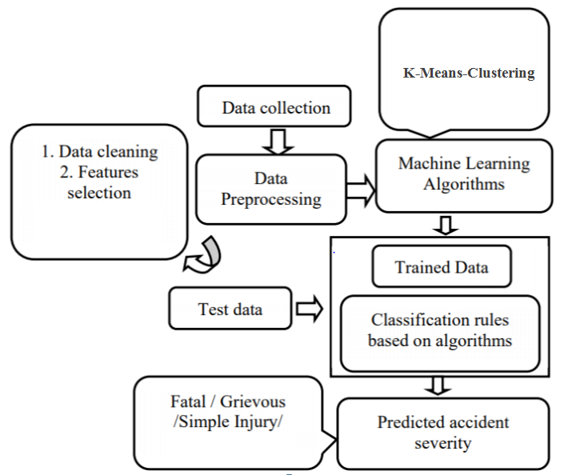
U20CSPR02- MAJOR PROJECT : REVIEW-3
DESIGN METHODOLOGY:

Slide 12
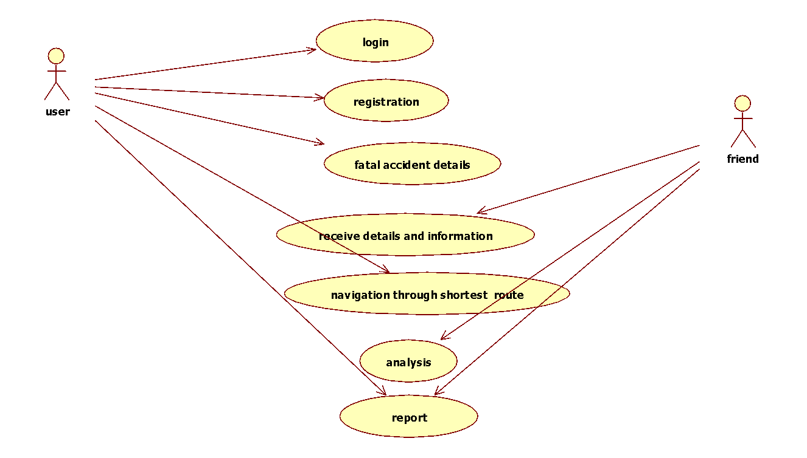
U20CSPR02- MAJOR PROJECT : REVIEW-3
DESIGN METHODOLOGY:
USE CASE DIAGRAM

Slide 13
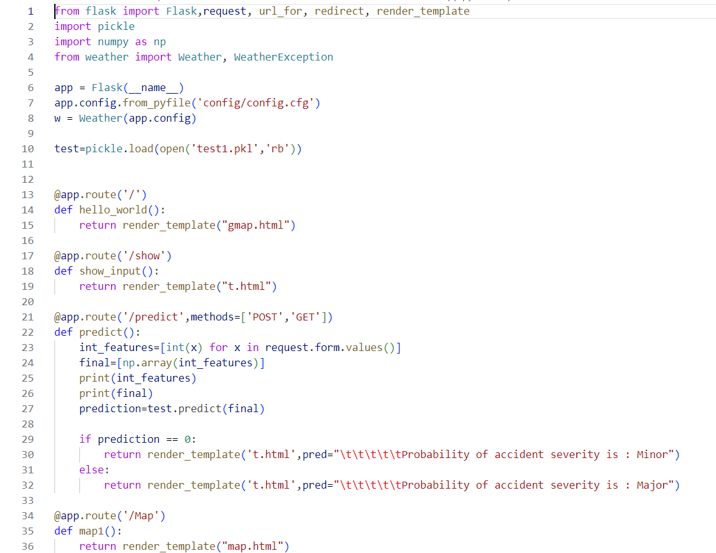
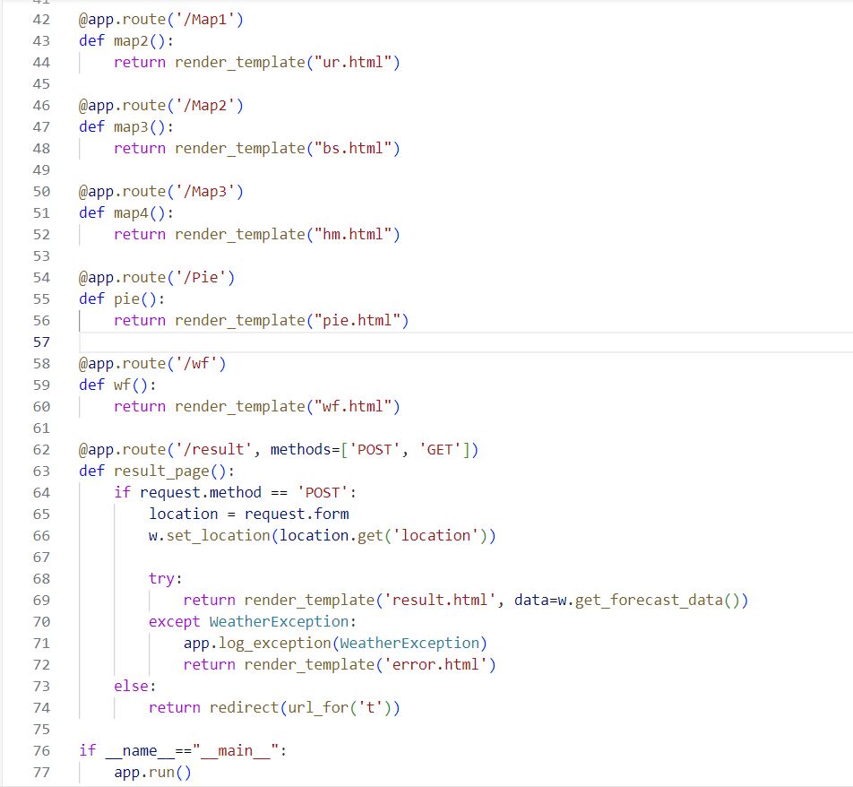
U20CSPR02- MAJOR PROJECT : REVIEW-3
Source code Demonstration and Presentation:
APPLICATION CODE:

Slide 14
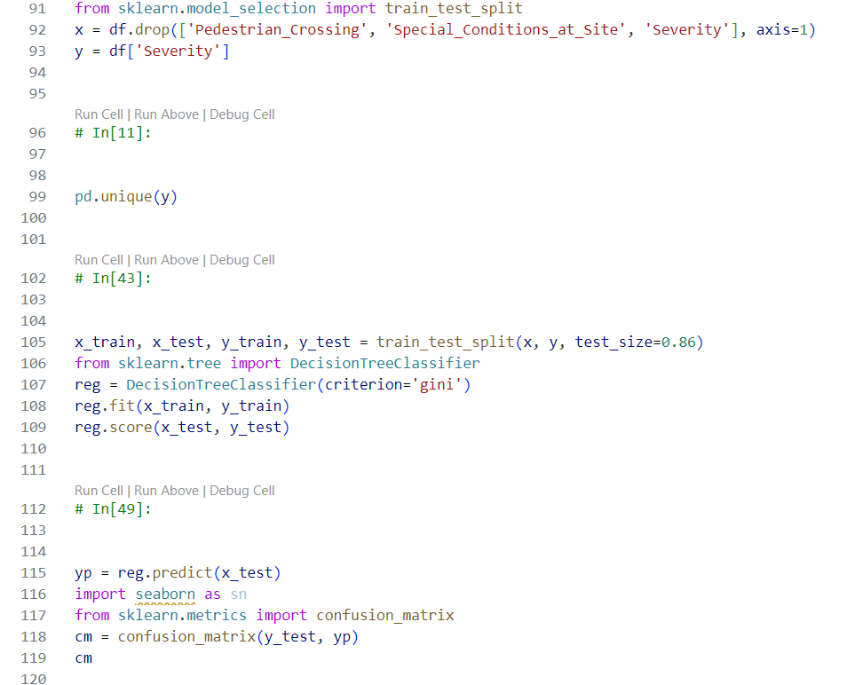
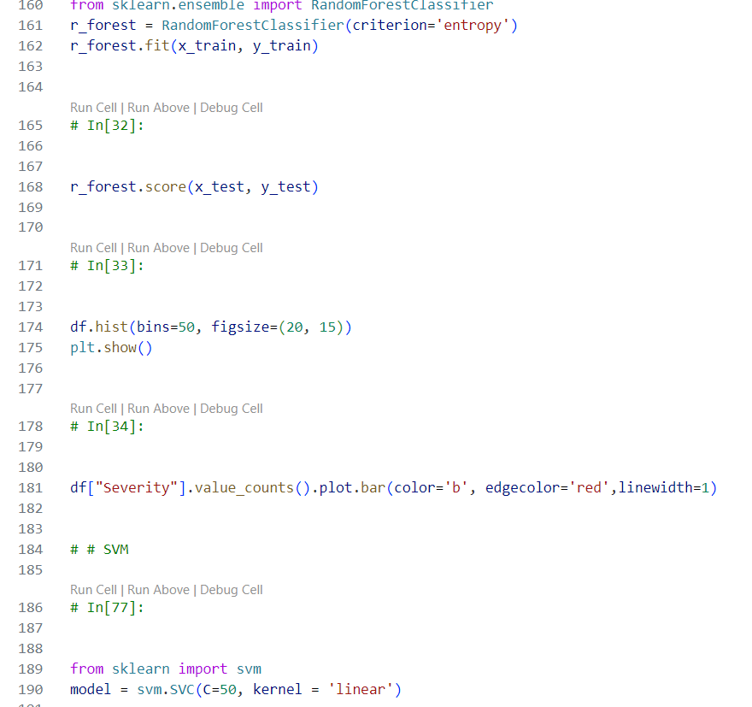
U20CSPR02- MAJOR PROJECT : REVIEW-3
Source code Demonstration and Presentation:
MODELS FOR PREDICTION:

Slide 15
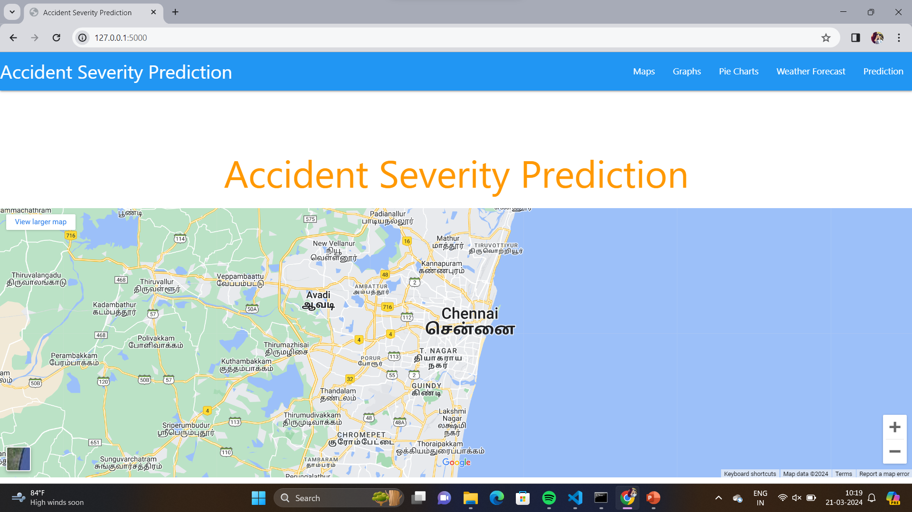
U20CSPR02- MAJOR PROJECT : REVIEW-3
Result and Discussion:

Slide 16
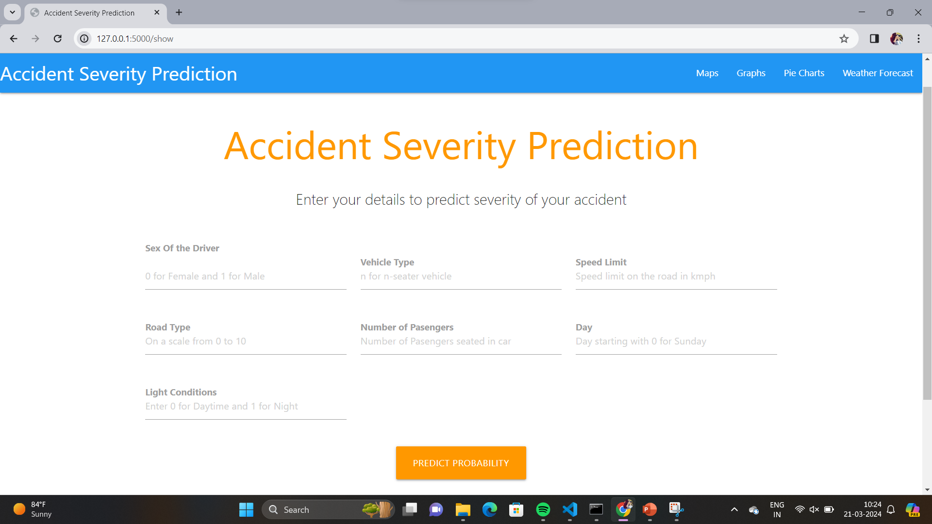
U20CSPR02- MAJOR PROJECT : REVIEW-3
Result and Discussion:

Slide 17
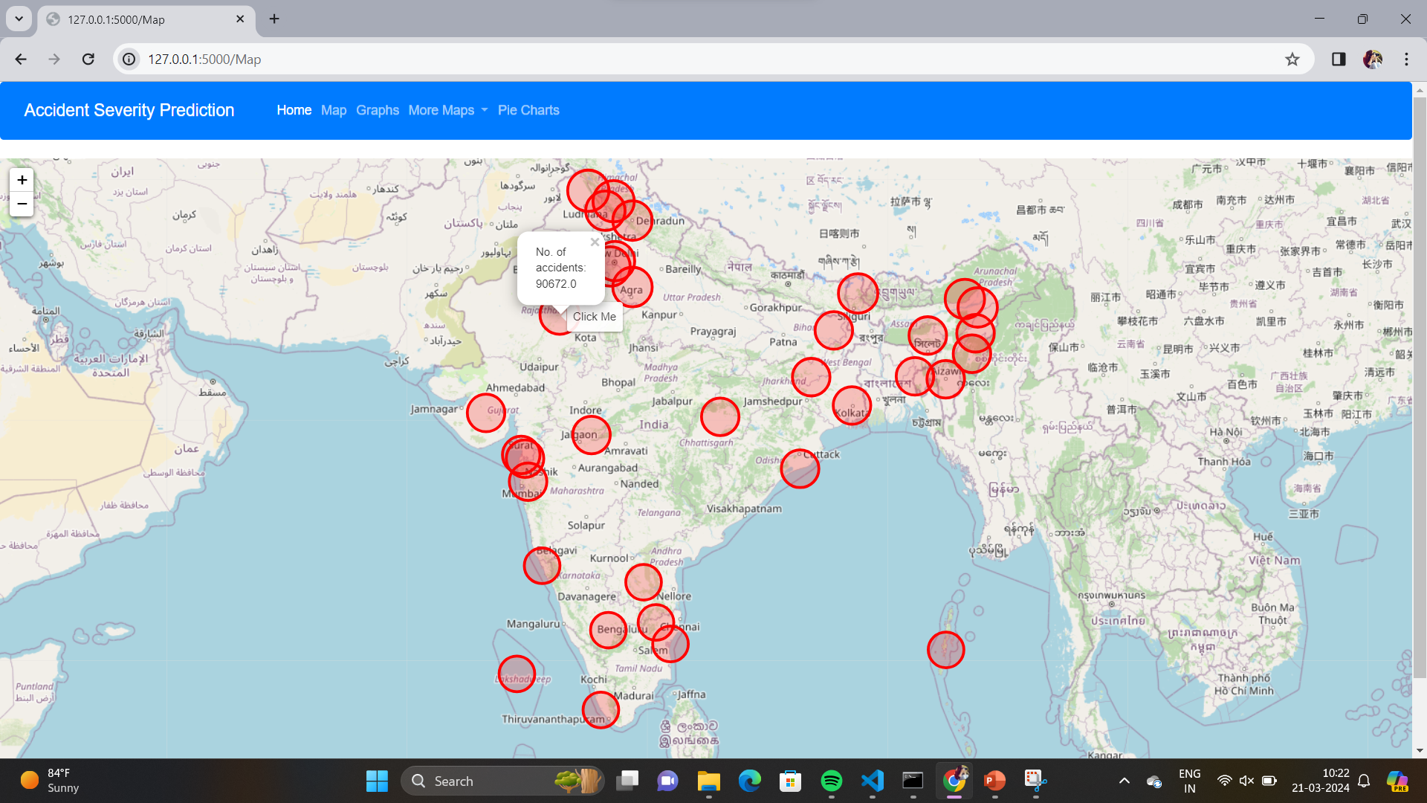
U20CSPR02- MAJOR PROJECT : REVIEW-3
Result and Discussion: Implementation and analysis

Slide 18
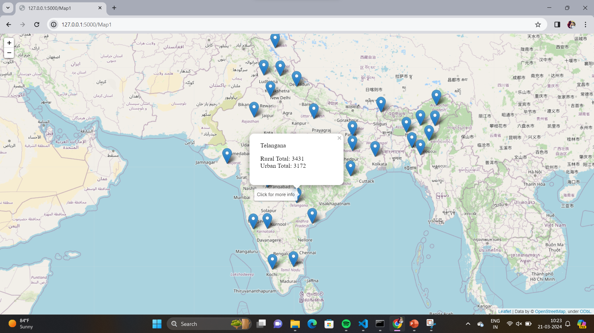
U20CSPR02- MAJOR PROJECT : REVIEW-3
Result and Discussion:

Slide 19
U20CSPR02- MAJOR PROJECT : REVIEW-3
Conclusion and Future scope:
Environmental factors like roadway conditions have minimal impact on fatal rates
compared to human factors like intoxication and collision types.
Regional analysis reveals disparities in fatal rates, signaling the need for targeted safety
measures in high-risk areas.
Data scarcity remains a challenge, limiting the depth of analysis and decision-making.
Additional data sources, such as non-fatal accidents and weather conditions, are
crucial for more comprehensive insights and actionable recommendations.

Slide 20
U20CSPR02- MAJOR PROJECT : REVIEW-3
Future scope:
We have developed the project of traffic accident analysis it will predict based on the person coming by and which type vehicle and etc..
In future we will develop something like forecasting before you going on the road at the time you can analyze the road by using this.
Even it would be predict the historical places wherever you’re across the road , it give the information about the places while travelling..

Slide 21
U20CSPR02- MAJOR PROJECT : REVIEW-3
TEAM ALLOCATION :
Candidate Name | Responsibility
Saidugari Swamy | Team Leader /Source Code Developer
Samala Krishnavamshi | Data collection
Sandra Swetha Kiranmai | Model Deployment
Tanikonda Srivallika | Project Integration

Slide 22
U20CSPR02- MAJOR PROJECT : REVIEW-3
REFERENCES:
[1] Divya Bansal and Lekha Bhambhu. Execution of Apriori algorithm of data mining directed towards tumultuous crimes concerning
women. International Journal of Advanced Research in Computer Science and Software Engineering, 3(9), September 2013.
[2] Amira A El Tayeb, Vikas Pareek, and Abdelaziz Araar. Applying association rules mining algorithms for traffic accidents in
dubai. International Journal of Soft Computing and Engineering, September 2015.
[3] William M Evanco. The potential impact of rural mayday systems on vehicular crash fatalities. Accident Analysis & Prevention,
31(5):455–462, September 1999.
[4] K Jayasudha and C Chandrasekar. An overview of data mining in road traffic and accident analysis. Journal of Computer
Applications, 2(4):32–37, 2009.
[5] S. Krishnaveni and M. Hemalatha. A perspective analysis of traffic accident using data mining techniques. International Journal of
Computer Applications, 23(7):40–48, June 2011.
[6] Sachin Kumar and Durga Toshniwal. Analysing road accident data using association rule mining. In Proceedings of International
Conference on Computing, Communication and Security, pages 1–6, 2015.

Slide 23
U20CSPR02- MAJOR PROJECT : REVIEW-3
REFERENCES:
[7]. Tavakoli Kashani, A., & Sayyah, S. M. (2016). A comparative study of decision tree ID3 and C4.5. International Journal of Advanced Studies in Computer Science and Engineering, 5(1), 8-13.
[8]. Kumar, M., Paliwal, M., & Kumar, U. (2017). Comparative analysis of decision tree algorithms for road accident severity prediction. International Journal of Engineering Research & Technology, 6(1), 236-240.
[9]. Quddus, M. A., Ochieng, W. Y., & Noland, R. B. (2009). Predicting road traffic accident severity: A case study of Dhaka metropolitan city, Bangladesh. Accident Analysis & Prevention, 41(3), 591-598.
[10]. Wang, C., Quddus, M. A., & Ison, S. G. (2009). Traffic accident injury severity analysis using classification tree methods. Journal of Safety Research, 40(6), 435-444.

